Slide 1
MRRA Budget 2018
Budget Presentation April 3, 2018
Prepared by Karen Scammell,
And program managers

Slide 2
MRRA Budget Package April 3, 2018
Programs and Membership Fees
Equipment Purchase & Sale Recommendations
Budget 2018
Vote on Budget
Discussion on additional items
2

Slide 3
MRRA 2018 Programs and Membership
3
Notes:
3

Slide 4
Base MRRA Membership Fee
Base Membership **
$150 membership fee
- Discount of $25 if paid by January 15, 2018
$75 for college students
Base membership fee is paid by all club members
Base fee covers fixed costs of operating the club
Maintain principles of club membership fees
Additional fees based upon program and equipment
** Already approved at December 2017 annual meeting
4
Notes:
4

Slide 5
UML Boathouse User Fee 2018
Increase of 5% for user fee for FY 2018/2019
Takes effect with July 1 Payment
MRRA has paid the same amount for about 10 years
$720 total increase
New: Fee of $500 per regatta; this is on top of the $2 per head fee
Fee of $500 per regatta to use launches (payable to UML Rowing)

Slide 6
How Boathouse User Fee is Applied
Boathouse User fee from 2010 through June 30, 2018:
$14,400
$4,000 attributed to number of members (Membership Fee)
$4,900 attributed to MRRA club boat space (Logbook Sculling)
(Presently 10 singles, 5 double/pair, 2 Quads
Not counting 3 Zephyrs stored outside
$5,500 attributed to Rack Holders (18 indoor spots)
Boathouse User fee starting July 1, 2018 -> 5% increase = $15,120
$4,200 to members
$5,145 attributed to MRRA club boat space ($6 per Logbook sculler increase)
$5,775 attributed to Rack Holders ($15 per rack holder increase)

Slide 7
Summary Sculling Fees: 2018 YEAR
Rack fees at $400/year. Due March 15
Outdoor rack space (if available) offered at $150
High Storage (if available), offered at $50 for season
Logbook sculling $250 - unlimited use of club sculling boats (and as 2-)
Family membership of $150, each member
Same privilege as full paying member
Married /domestic couples, children <24 , living at same address
Restricted Logbook sculling: $150
Row after 9am; no reservations; no offsite racing
Racing Associate: $150
Member of a Regatta Central registered club; rows with a member always
Priority to paid Logbook sculling/ Sweep program in case of conflict

Slide 8
Program Fees to be discussed
The Membership/programs committee is being asked to look at offering
Reduced logbook sculling fee for rack holders
The rationale is that rack holders are interested in very limited access to club equipment early and late in the season and to train in team boats
Reduced logbook sculling fee for full paying Masters Sweep
The rationale is that Masters Sweep only goes out 2X/week and there is interest in sculling at other times.
We need to balance the interest of our current members to have access to club sculling equipment at peak times vs. having this equipment available to new members to grow the club.

Slide 9
Summer Student - Rules
Full Time Student enrolled at an accredited School or University
Age 18 – 24 years
Rowing Allowed from 1 June through 31 August
After 8am weekday; 9am weekend
No reservations for boats
No off-site boat use/racing, unless approved by boat captain
$75 Membership Fee PLUS
$125 restricted logbook sculling or Open Sweep
Keep consistency between sculling and sweep
OK from Boatcaptain for use of “A” boats
If sweep, must go out with OSweep or as a fill-in for MSweep
Since is restricted, pay same price as logbook restricted rowing
Scullers must pass the boat captain’s test
OpenSweep adds Restricted Sculling for $125

Slide 10
Coaches
All Coaches must be approved by the boat captain or MRRA president (or designee)
Must register as a non-voting member on the MRRA website
Must have CPR and preferred to also have First Aid certification
Must have launch training
Are provided with off-peak sculling privileges and can row as a substitute in Sweep programs
Must pass boat captain’s test for sculling

Slide 11
Advanced Coached Sculling
Target improved racing performance
Coaching One Weekday morning (Tuesday)
* 5:30 – 7am
* 6 people max
* Start May –
Coach: Mark or Karen Crouthamel
Program Manager: Karen Scammell
Cost: $70 per 6 week program, if 6 members
- otherwise adjusted proportionally for # members

Slide 12
Masters Group Sculling
Objective is to offer camaraderie and fun of rowing with others; Target team boats with rowers rotating in singles based on availability
Informal group that will meet one or two mornings - Mon, Wed, Fri @ 5:30 AM – 7:00 AM
Starts TBD
Initially no coaching – if group wants to add, will arrange coaching 1-2 days and group pays for that
Program Manager: Linas Alinskas
Cost: $0 without coaching; TBD with coaching

Slide 13
Learn To Scull
LTS I/II: each a 6 week program, with 2 sessions/ wk
LTS I : May 29th through July 10th
LTS II: July 17 through August 21st
Tuesday evening /Saturday morning
Program Fee $275 each session
$75 for MRRA base membership when pass captains test and $125 for logbook sculling
Program Co-Managers, Linas Alinskas & Andy Hutchinson
Coach: Marcia Beckett

Slide 14
Come Back to Sculling Days
MRRA pays for 2 coaching sessions
Welcome back prior years LT scull (email going 4-5 years past) and Sweep Rowers
Current members welcome
Refresher on how to carry boat, puts the oars in, row
Use Barge for Sweep
Estimate mid May and Learn to Row Day (June 2)

Slide 15
Learn to Sweep – Masters
Need commitment of at least 8 -10 sweep rowers (max 20)
Three @ 4-week programs, 2 rows/week
Start mid June
Mon & Wed evening 6 - 7:30pm
Saturday only program – 8 rows (try this if enough interest)
Recommended Fee
$99 for MRRA Members who are already paid sculling
Non-member $125 or Bring a Friend special – both pay $99
Must become non-voting members after Session 2 at $75 each
Coach: Jonah Sakala
Program manager – Terry Freeman

Slide 16
Masters Sweep I/II
12 weeks each
2 rows/wk = 24 sessions:
Mon-Wed evening
Start late April/ early May
Includes coaching; coxing if available; more experienced will try the 4-
Race in Masters Regionals in July, TRR, HOCR
Recommended Fee : $325
Coach: Alex Gavriel
Program manager –Jody DeCarolis

Slide 17
Open Sweep Men/Women Summer
Summer Student for experienced sweep rowers looking to compete at local and national races
Structure like Logbook Sculling
$125 for summer student (plus $75 summer student membership)
Coach: Yes, TBD
Coxswain – Not paid; gets free base membership & restricted sculling (must pass boatcaptains test)
Row 2 times/week on Tues – Thurs evening
$125 for off-peak sculling
Will be racing and will pay those fees separately
Board Liaison– Karen Scammell
Program Manager – Mike Carenza Scholz

Slide 18
Programs Summary
MSweep - (M/W, 6 pm)
OSweep Men/Women (T/Th 6pm )
LTScull I - (Tu 6:30pm, Sat at 7am; start after LT Row Day)
LTScull II - (Tu 6:30pm, Sat at 7am; starts late July)
LTSweep I thru IV - (M,W 6pm, starts mid June after LT Row Day)
Adv Coached Sculling (Tues 5:30 am, start May)
Masters Group Sculling (M/W/F - 5:30am, starts early May)

Slide 19
Equipment Committee
Chairperson: Andy Raitto
Board Liaison: Bob Sengstaken
Historically use regatta funds for boat purchases
Should not use “future” regatta funds – just prior year funds
Responsible for managing rack space, equipment maintenance & purchase/sale

Slide 20
Purchase
Base Assumptions for Equipment
1. Board allocated up to $9K for equipment purchases for 2018
(which is TRR 2017 Transfer)
2. Base assumptions
No additional space inside or outside boathouse
Accomac 4X will go on trailer outside
3. Rental fee for one UML launch any day is $2500 for 2018
- Through Aug 31st; budget another $500 for Sept-Oct
4. Sweep boat rental rate will be $2,000 through Aug 31st
- no boat conflicts spring or summer
- budget $600 for Sept-Oct; schedule TBD

Slide 21
Equipment Committee 2018
Equipment Sales Recommendation
Sell the Swift HW and MW ($1000 each, min)
Sell the Peinert P1 ($800 offer accepted by MRRA)
Net proceeds $2,800
Purchase
8 sweep oars - $3,000
4 sets sculling oars - $2,000
Various tools for toolbox and pitch - meter: $300
Total Equipment purchases: $5,300
Net Equipment Expenditures: $2500
Request to put $6,500 into 2019 Allocation
Also Reserve the right to purchase a boat, should the committee and board agree, if something that fits our fleet needs becomes available in 2018
- Because the above boat sales leaves 1 MRRA-owned equipment spot.

Slide 22
Safety Committee – Budget 2018
Board Liaison: Joe LaFreniere
Chairperson: Mark Romanowsky
Safety Committee Proposed Budget 2018
Replenish First Aid Supplies....................................................$50
Buoy (Overtons Item # 309779 wl Hazard/Rocks label)......$320
anchor.....................................................................................$20
Line.........................................................................................$20
Air Horns (small).....................................................................$50
Air Horn (large).......................................................................$25
Stern facing white lights.......................................................$120
Water thermometers..............................................................$20
Miscellaneous.......................................................................$100
Total: $725

Slide 23
Safety tentative Agenda items 2018
Schedule FLIP CLINIC suggest co-ordinate with LTScull
Show Safety Video at Meetings and
Arrange for small group showings of Safety Video
Post Traffic pattern inside boathouse and at dock
Work with boathouse user group on any other safety activities
Conduct Launch training class (very popular in 2017)

Slide 24
Social Events Planned 2018
Board Liaison: Terry Freeman
Chair: Dottie Semonian
Request $500 for Social Committee – mostly refreshments for below:
March Member Meeting:
St Patrick's Day Snacks
April/May:
Group Rows (tbd)
June:
Learn to Row Day: Saturday, June 2nd - ill provide refreshments
Breakfast after Learn to Scull Session
July:
Member Meeting: Deck meeting with cocktails, invite new Learn to Members
Full moon row (7/27)
August:
Full moon row (8/26)
September/October:
End of season row down, clean up and pot luck
December:
Organize food, decoration for annual member meeting/party
Bumper Stickers $2
24
Notes:
24

Slide 25
MRRA 2018 Budget
MRRA Club Meeting
April 3, 2018

Slide 26
Detail on membership –Target 99 members
 | Price $ | # members
Membership discounted | 125 | 41
Membership full price | 150 | 40
Membership Student or Half Year | 75 | 18

Slide 27
Historical Programs / Revenues $
 |  | 2018 BUDGET | 2017 | 2016 | 2015 | 2014
Income
 | Membership | $12,475 | $ 11,250 | $ 11,250 | $ 9,730 | $ 10,535
 | Sculling | $25,500 | $ 24,835 | $ 24,835 | $ 23,945 | $ 22,045
 | Sweep | $17,390 | $ 16,150 | $ 16,150 | $ 14,050 | $ 5,692
 | TOTAL | $55,365 | $ 52,235 | $ 52,235 | $ 47,725 | $ 38,272
Expense | Operating | $36,320 | $ 35,341 | $ 35,341 | $ 30,265 | $ 27,618
 | Programs | $14,440 | $ 12,980 | $ 12,980 | $ 9,620 | $ 8,625
 | TOTAL | $50,760 | $ 48,321 | $ 48,321 | $ 39,885 | $ 36,243
Operating Net Revenue |  | $4,605 | $ 3,914 | $ 3,914 | $ 7,840 | $ 2,029
Regattas and Equipment Buy/Sell
 | Festival Regatta | $4,500 | $ 6,487 | $ 3,600 | $ 4,340 | $ 9,000
 | Transfer from TRR | $8,000 | $ 9,000 | $ 8,000 | $ 13,000 | $ 13,000
 | Sale of Boats | $2,800 | $ 2,500 | $ - | $ - | $ 2,500
 | Equipment Purchase | $5,500 | $ (12,000) | $ - | $ - | $ (19,500)
 | TOTAL | $20,800 | $ 5,987 | $ 11,600 | $ 17,340 | $ 5,000
Net Cash Increase (Decrease) |  | $25,405 | $ 9,901 | $ 15,514 | $ 25,180 | $ 7,029

Slide 28
Program Budgets 2018 ($)
Program P & L |  | Base | Club Scull | Rack | Learn To Scull | Learn To Sweep | Master Sweep | Open Sweep | TOTAL
Revenue |  | $ 12,475 | $ 13,500 | $ 7,600 | $ 4,400 | $ 4,840 | $ 11,050 | $ 1,500 | $ 55,365
Expense |  | $ 20,460 | $ 5,726 | $ 6,465 | $ 3,639 | $ 4,820 | $ 7,260 | $ 2,390 | $ 50,760
Operating Profit |  | $ (7,985) | $ 7,774 | $ 1,135 | $ 761 | $ 20 | $ 3,790 | $ (890) | $ 4,605
Members |  | 99 | 45 full/ 10 reduced | 18+2 | 16 | 3*12 | 18, 16 | 12
Per member rate |  | $ (80.66) | 20 Rack Holders
Per member rate w/o Legal |  | $ (30.15)
Note: The value of our fleet for insurance purposes is $92,000
Plus we carry $30K borrowed boat insurance for UML Sweep boats

Slide 29
Budget with Amendment – per Kscammell motion
 |  | 2018 BUDGET | 2017 | 2016 | 2015 | 2014
Income
 | Membership | $ 12,475 | $ 11,250 | $ 11,250 | $ 9,730 | $ 10,535
 | Sculling | $ 25,500 | $ 24,835 | $ 24,835 | $ 23,945 | $ 22,045
 | Sweep | $ 17,890 | $ 16,150 | $ 16,150 | $ 14,050 | $ 5,692
 | TOTAL | $ 55,865 | $ 52,235 | $ 52,235 | $ 47,725 | $ 38,272
Expense | Operating | $ 36,320 | $ 35,341 | $ 35,341 | $ 30,265 | $ 27,618
 | Programs | $ 14,920 | $ 12,980 | $ 12,980 | $ 9,620 | $ 8,625
 | TOTAL | $ 51,240 | $ 48,321 | $ 48,321 | $ 39,885 | $ 36,243
Net Revenue |  | $ 4,625 | $ 3,914 | $ 3,914 | $ 7,840 | $ 2,029
Regattas and Equipment Buy/Sell
 | Festival Regatta | $ 4,500 | $ 6,487 | $ 3,600 | $ 4,340 | $ 9,000
 | Transfer from TRR | $ 8,000 | $ 9,000 | $ 8,000 | $ 13,000 | $ 13,000
 | Sale of Boats | $ 2,750 | $ 2,500 | $ - | $ - | $ 2,500
 | Equipment Purchase | $ 5,000 | $ (12,000) | $ - | $ - | $ (19,500)
 | TOTAL | $ 20,250 | $ 5,987 | $ 11,600 | $ 17,340 | $ 5,000
Net Cash Incr (Decr) |  | $ 24,875 | $ 9,901 | $ 15,514 | $ 25,180 | $ 7,029

Slide 30
Programs with KScammell Amendment
Program P & L |  | Base | Club Scull | Rack | Learn To Scull | Learn To Sweep | Master Sweep | Open Sweep | TOTAL
Revenue |  | $ 12,475 | $ 13,500 | $ 7,600 | $ 4,400 | $ 4,840 | $ 11,050 | $ 2,000 | $ 55,865
Expense |  | $ 20,460 | $ 5,726 | $ 6,465 | $ 3,639 | $ 4,770 | $ 7,210 | $ 2,970 | $ 51,240
Operating Profit |  | $ (7,985) | $ 7,774 | $ 1,135 | $ 761 | $ 70 | $ 3,840 | $ (970) | $ 4,625
Members |  | 99 | 45 full/ 10 reduced | 18+2 | 16 | 3*12 | 18, 16 | 12
Per member rate |  | $ 207 | 20 Rack Holders

Slide 31
Summary Budget 2018
Continue growth of sweep / sculling membership
Increase use of sculling boats across the day
MRRA is profitable before Regattas
Replacing / upgrading equipment ongoing
Strong cash position after purchases
Prepared for future plans – Boathouse Site
Advertise for all programs ASAP
Consider increasing Member Fees for 2019 by $25-$50
Extraordinary legal fees in 2018

Slide 32
Initiatives 2018
Run Successful Festival Regatta and TRR
Dottie Semonian will be Festival Regatta Director
TRR Board assigned by MRRA Board and determine regatta chair
TRR will be incorporated spring 2018
Increase awareness of Community Rowing aspect of the MRRA by promoting Lowell Community Rowing for Learn To programs.
Social media, print media, free and paid advertising
Improve retention by welcoming back Learn To Sweep and Scull members; offer mentoring

Slide 33
New MRRA Boathouse site
Keep Active with Pawtucketville Citizens Group, Lowell Government, Chelmsford and Tyngsboro Government to stay in the loop on any opportunities
Keep in touch with Bertos family on the site at 7A Middlesex Rd, Tyngsboro
Committee members: Karen Scammell, Jay Feenan, Bob Bowen, John Murphy, Dennis McCarthy, Mark Romanowsky

Slide 34
Motion to Accept the Budget

Slide 35
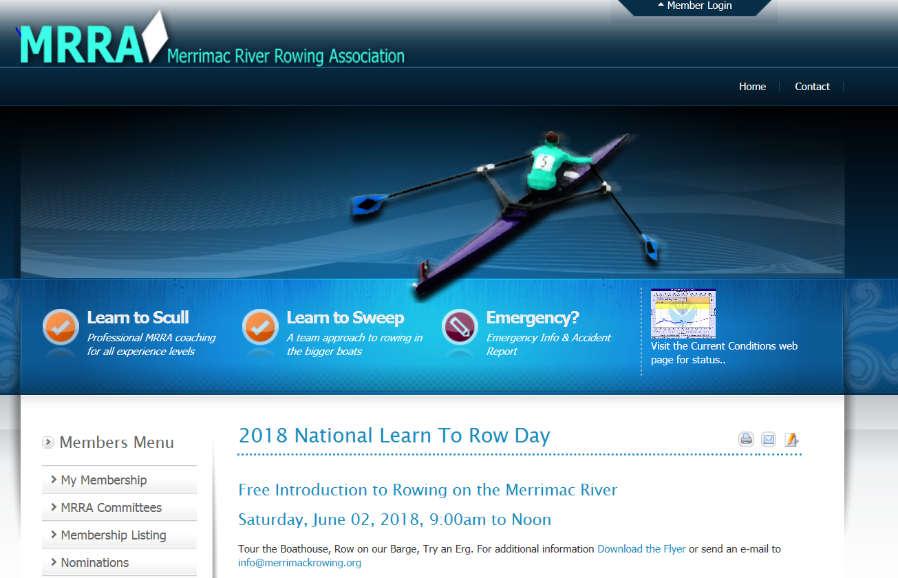
Other Business
Current Rowing Restrictions
Accident Report – on website. Please report all accidents and email to safety@merrimackrowing.org and board@merrimackrowing.org

Slide 36
Motion to Adjourn

